Slide 1
Marine Control System I
Project Presentation
Fan Gao
Hongyu Zhou
Shuyuan Shen

Slide 2
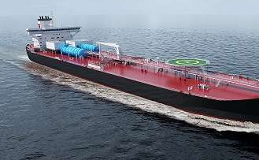
Content
Introduction
Part 2
Plant Model
Environmental Loads
Controller Design
Observer Design
Thrust Allocation
Simulation and Discussion
Conclusion

Slide 3
Introduction
A dynamic positioning system is designed for a vessel.
For part 1, reference model and PID controller are designed.
For part 2, complex environmental loads, 2 different observers and thruster allocation are involved.

Slide 4
Part 2 Design of a detailed Dynamic Positioning System

Slide 5
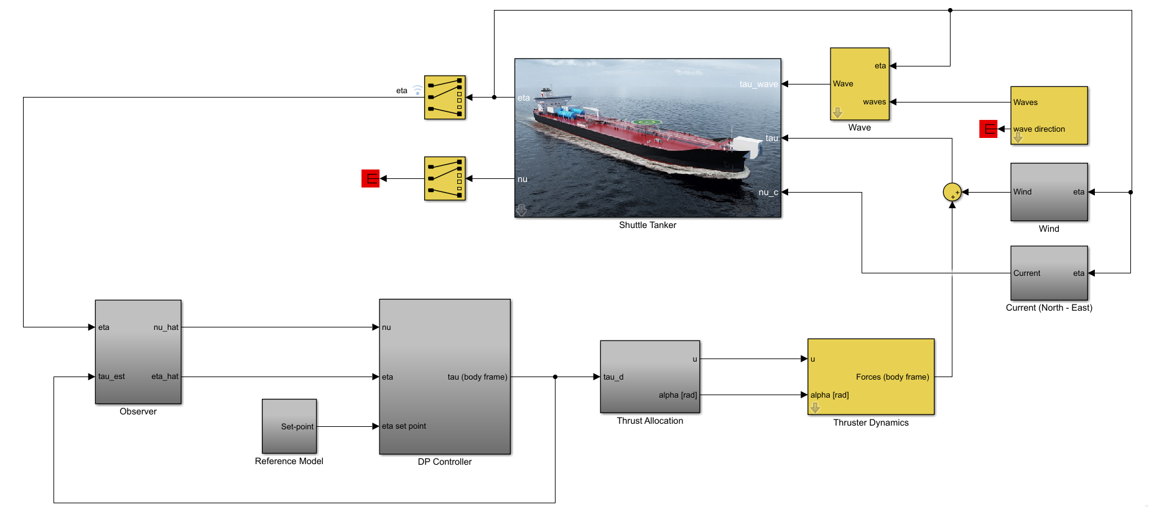
Part 2---Simulink Model

Slide 6
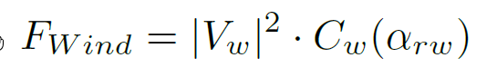
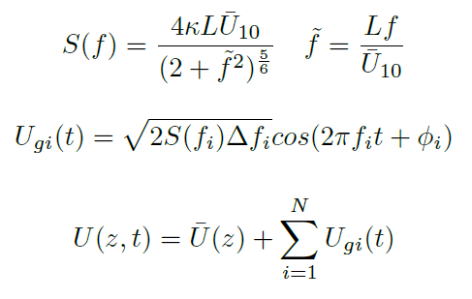
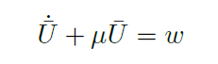
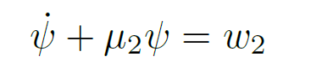
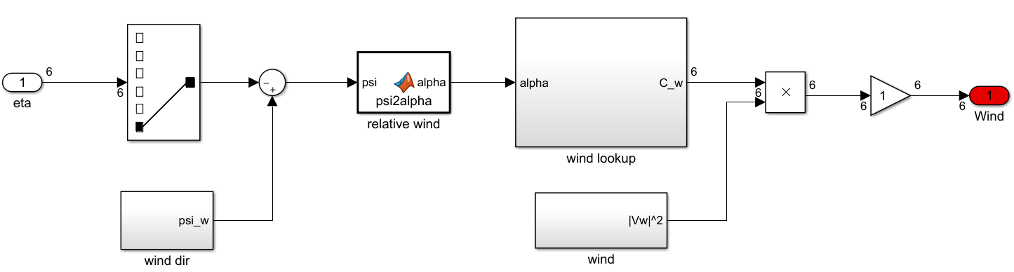
Part 2---Environmental Loads
Wind
mean value
fluctuating component

Slide 7
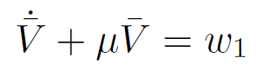
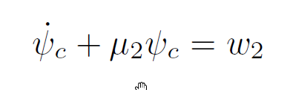
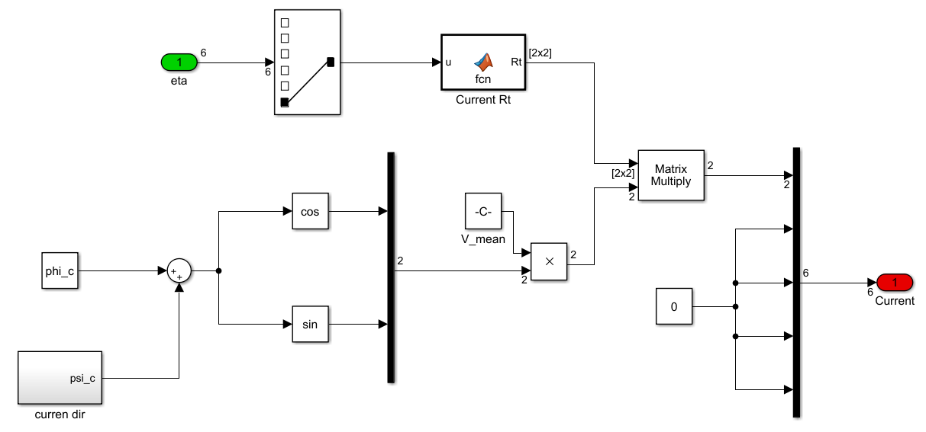
Part 2---Environmental Loads
Current

Slide 8
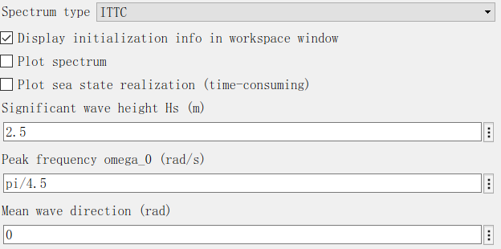
Part 2---Environmental Loads
Wave

Slide 9
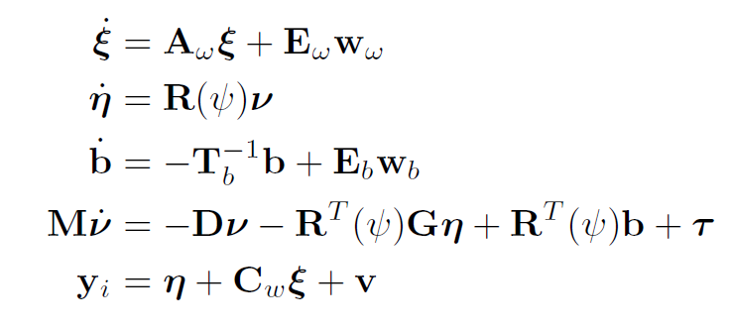
Part 2---Plant Model
Process Plant Model
Control Plant Model

Slide 10
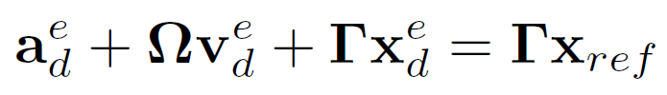
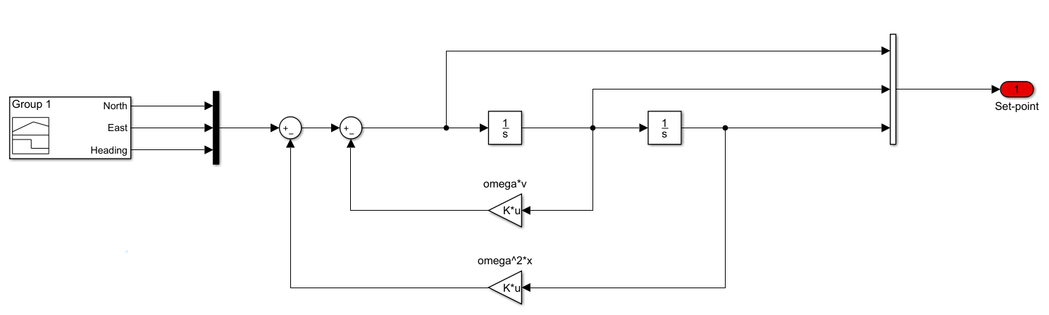
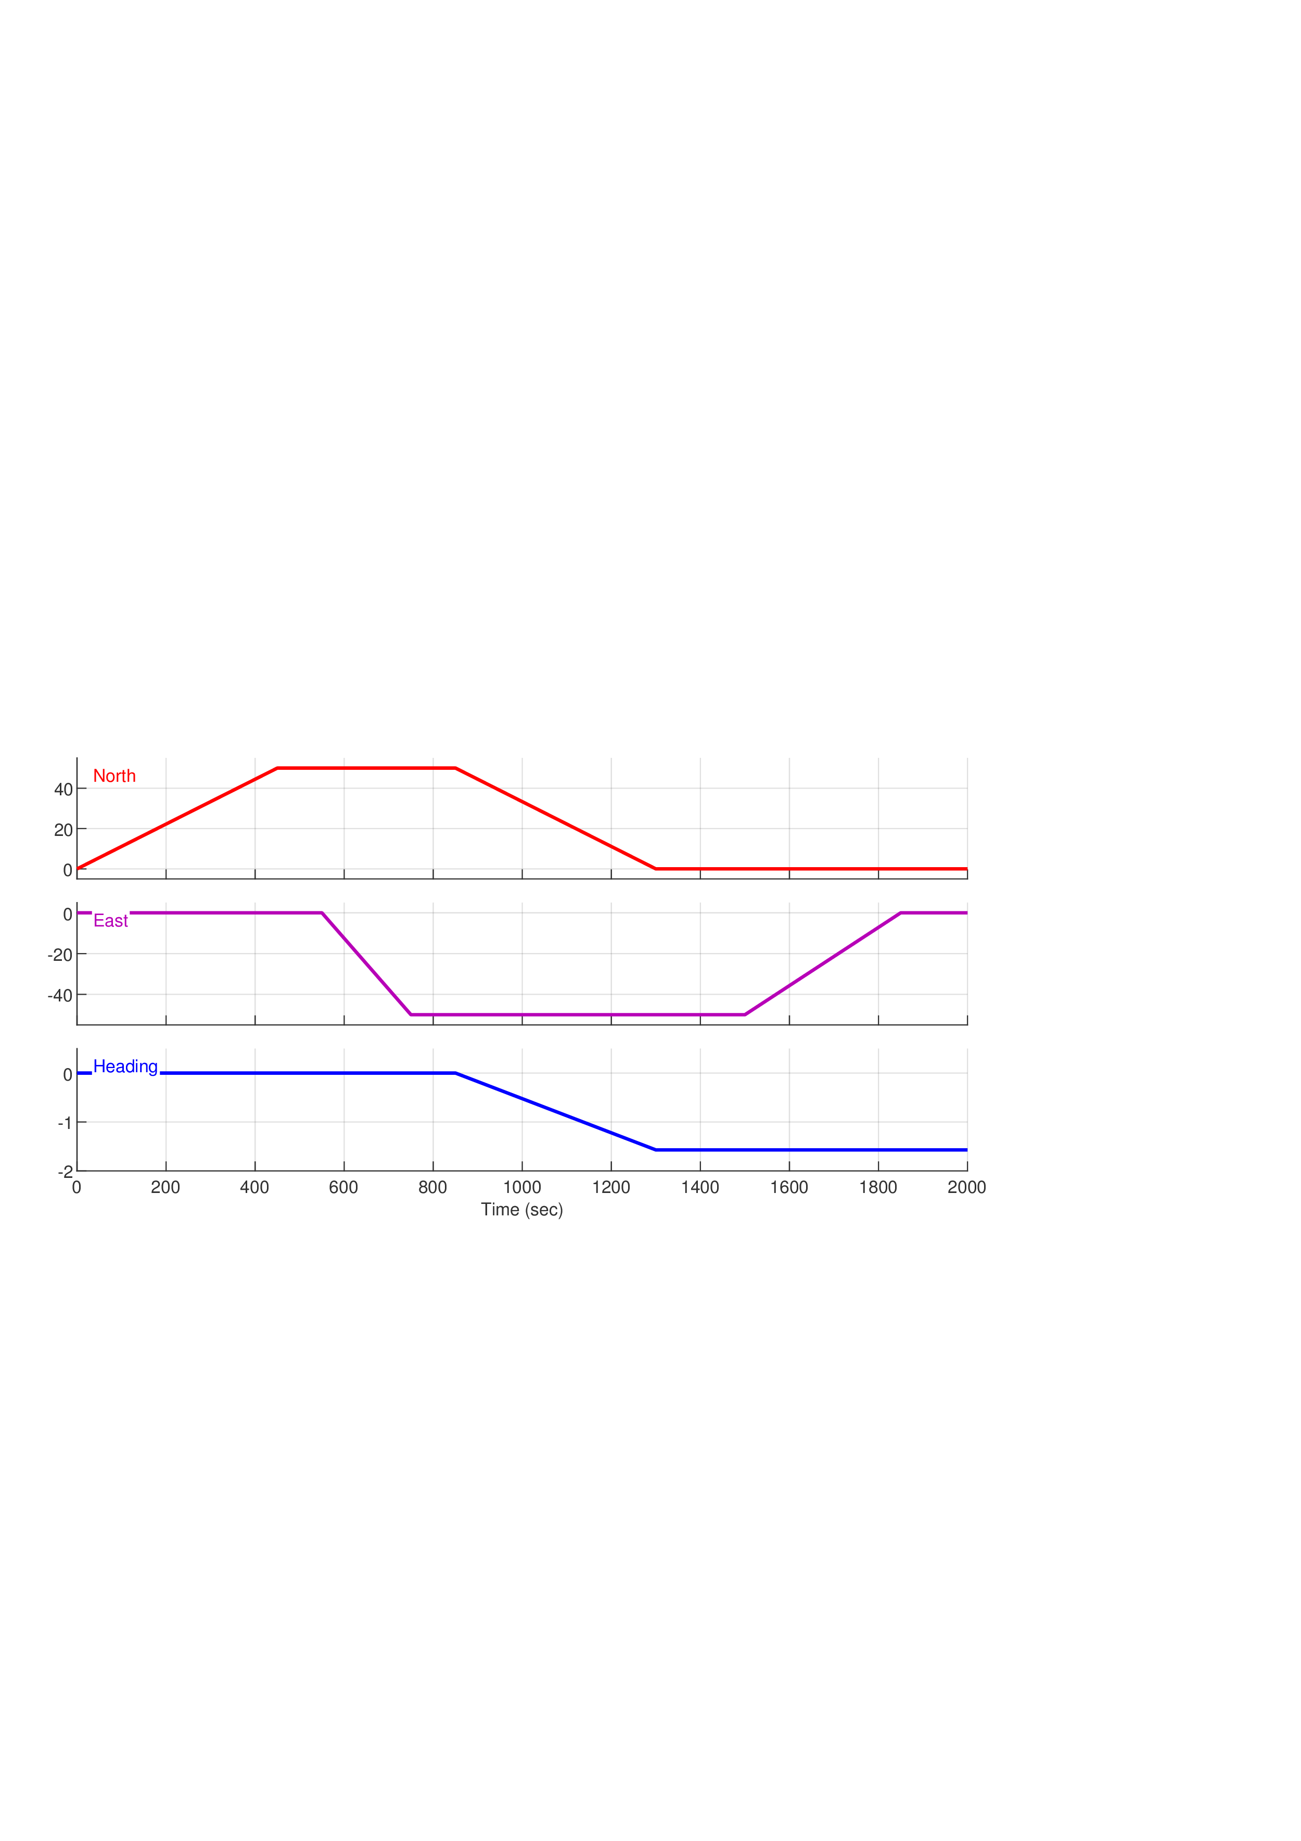
Part 2---Reference Model

Slide 11
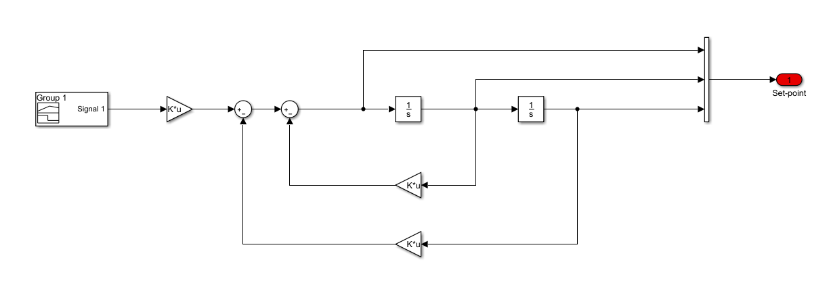
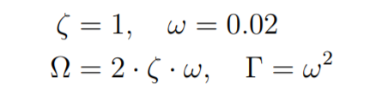
Part 2---Reference Model
Improvement

Slide 12
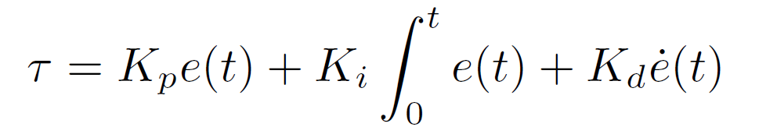
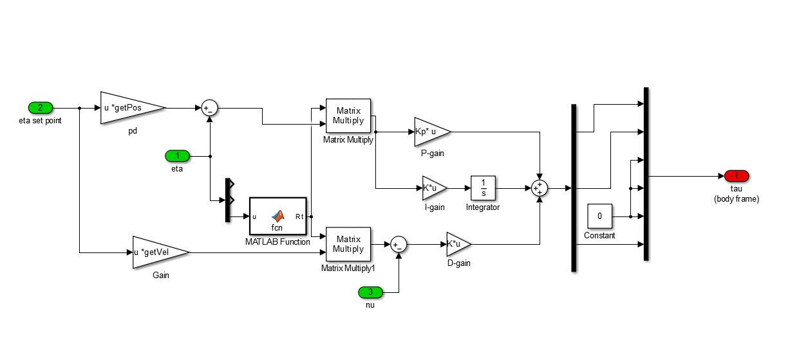
Part 2---Controller Design
PID controller

Slide 13
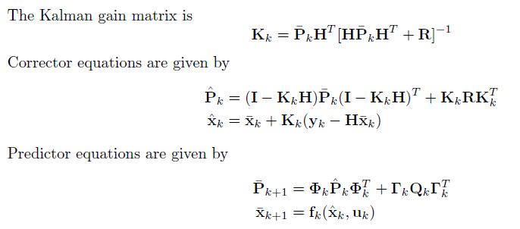
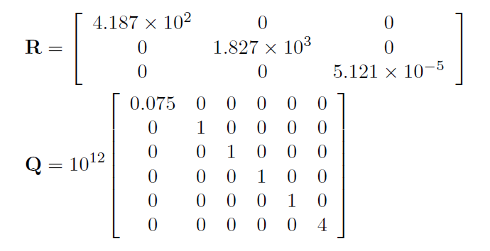
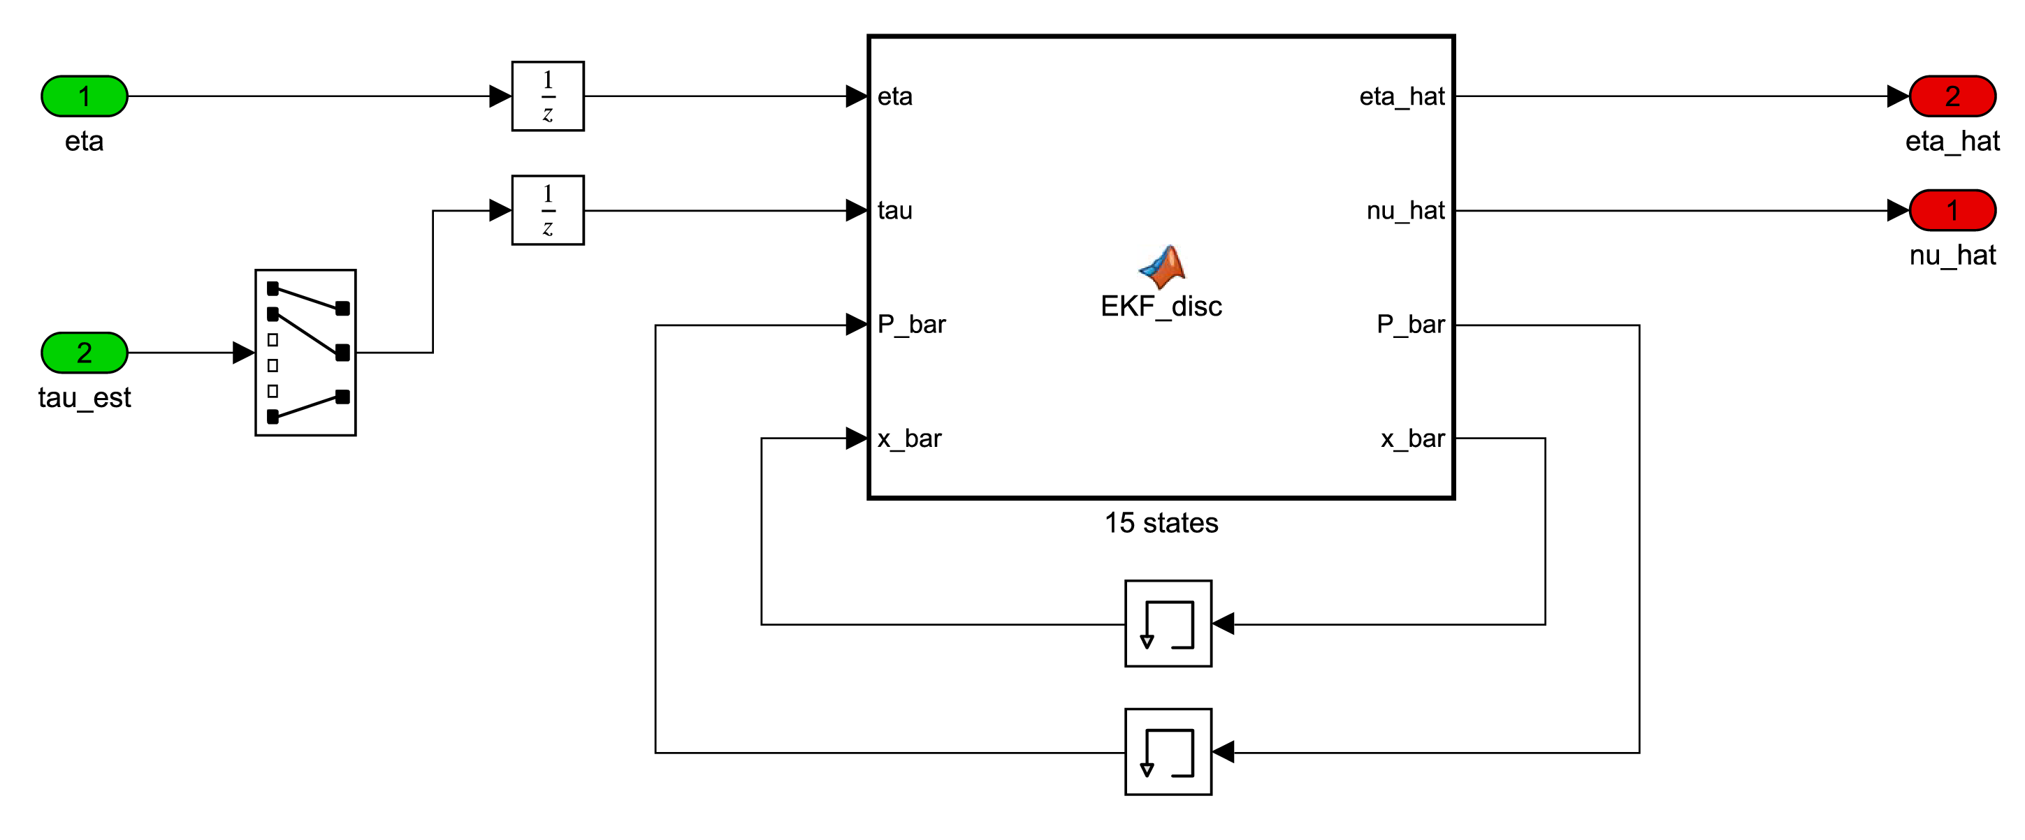
Part 2---Observer Design
Extended Kalman Filter

Slide 14
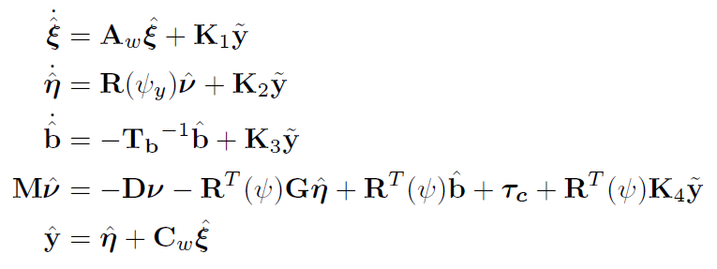
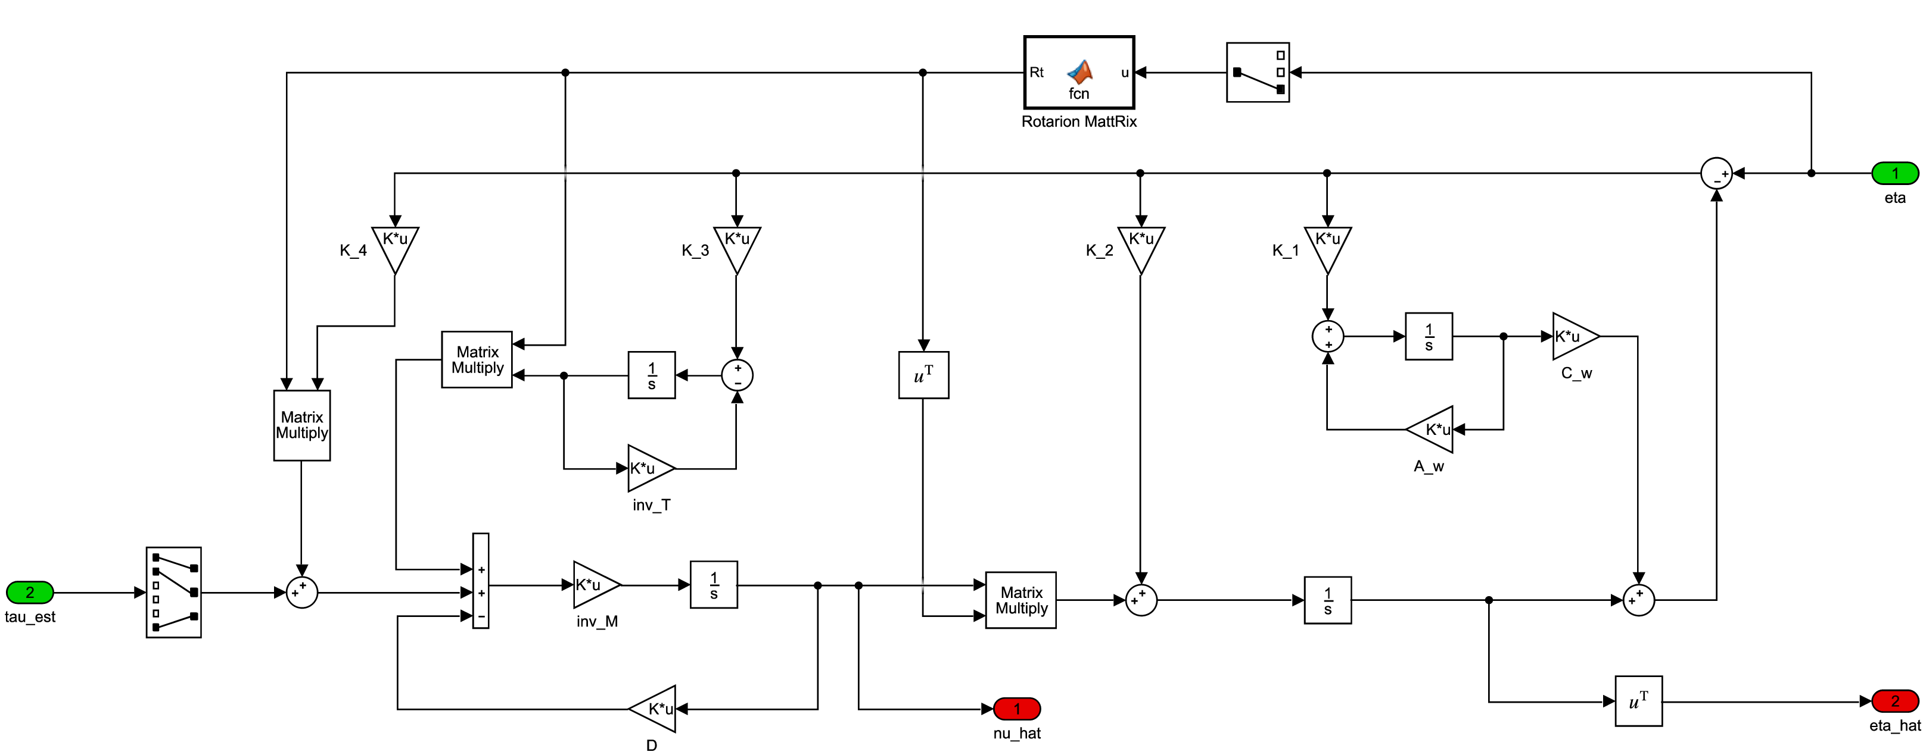
Part 2---Observer Design
Passive Nonlinear Observer

Slide 15
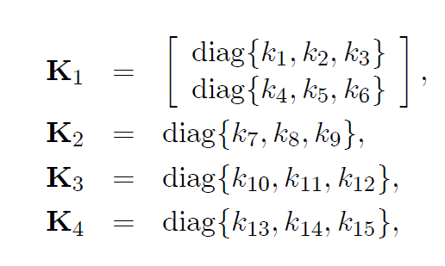
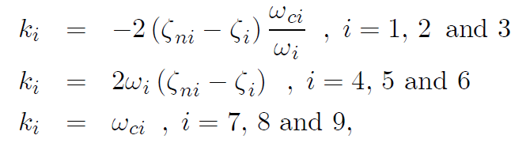
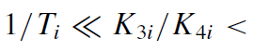
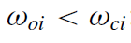
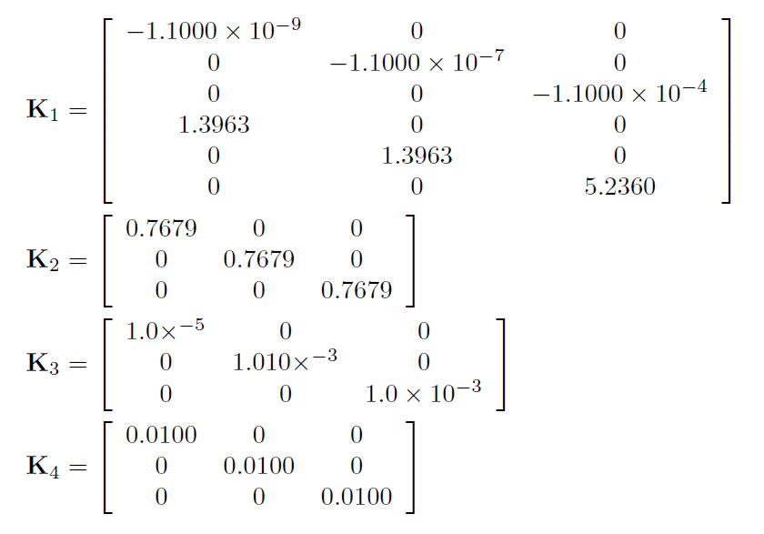
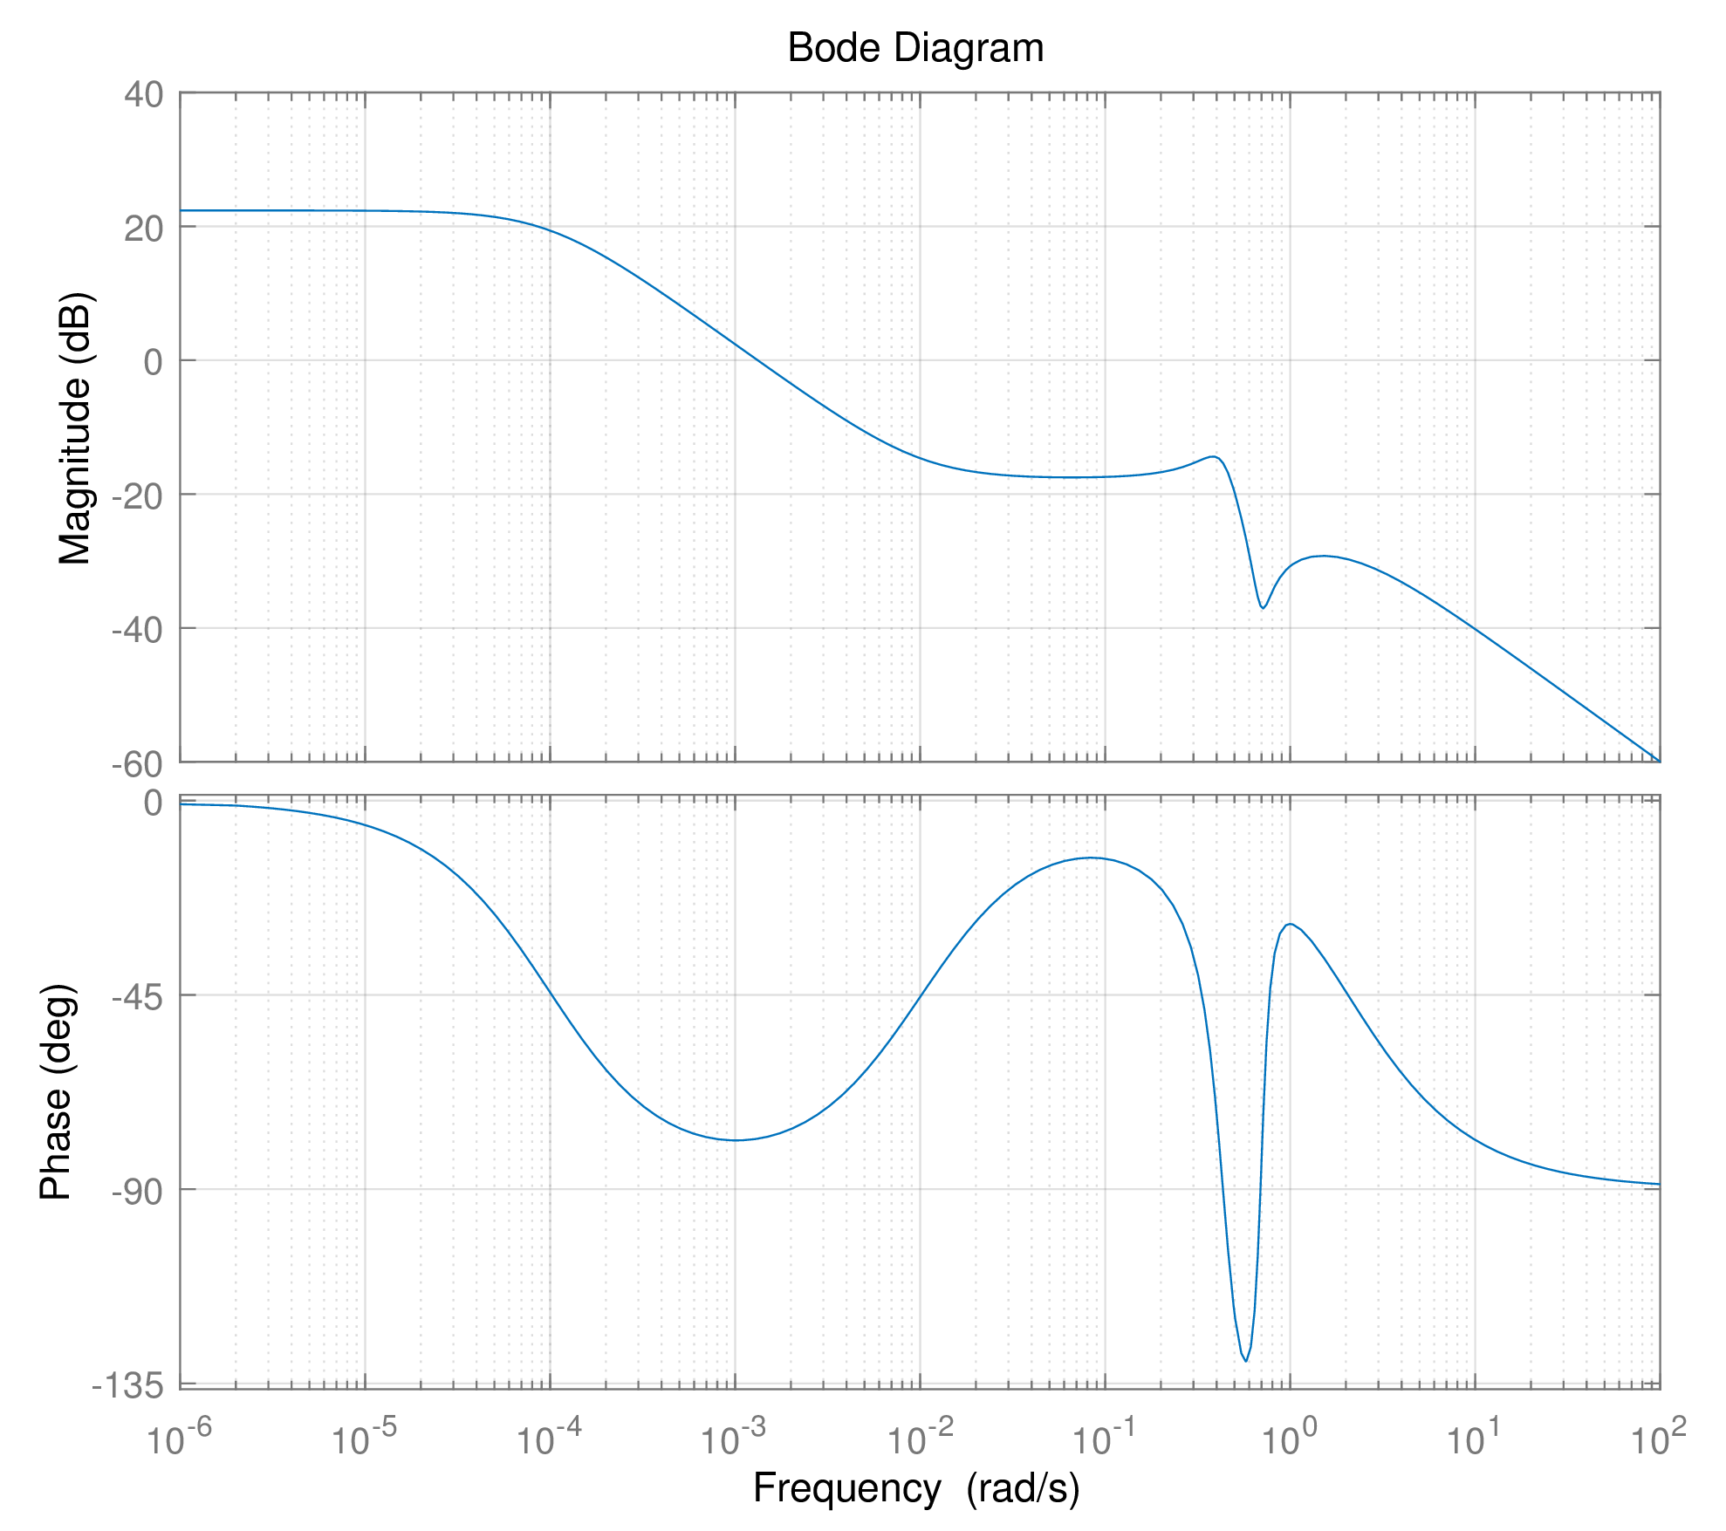
Part 2---Observer Design
Passive Nonlinear Observer

Slide 16
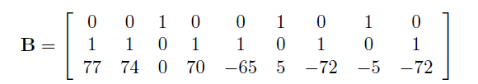
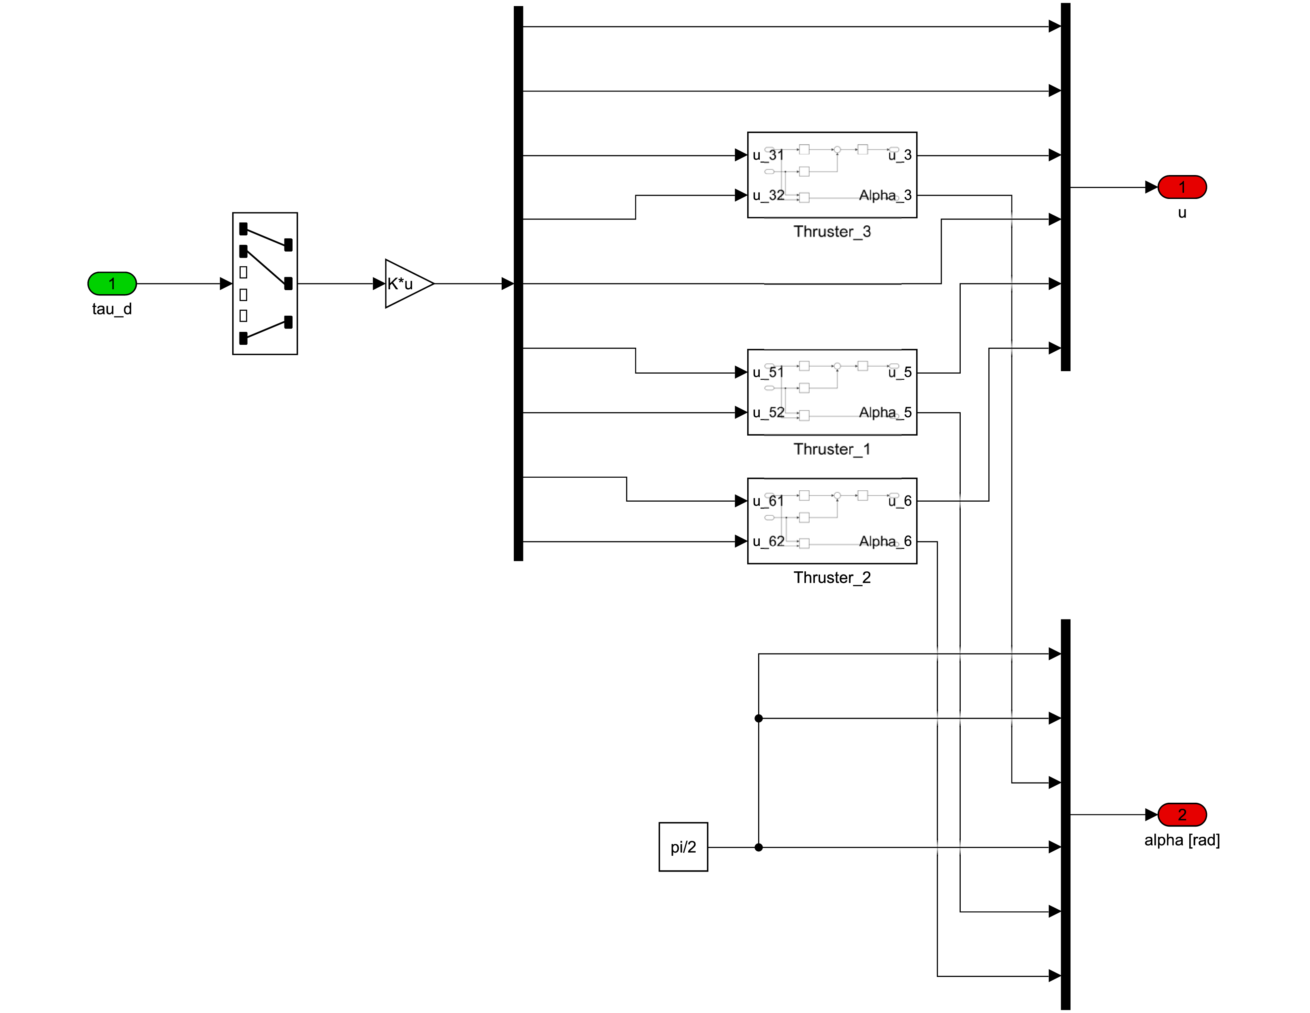
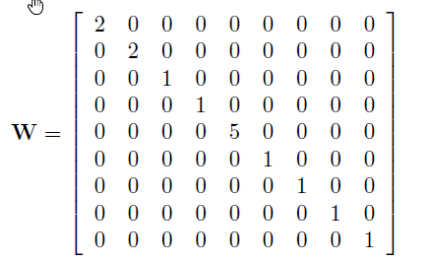
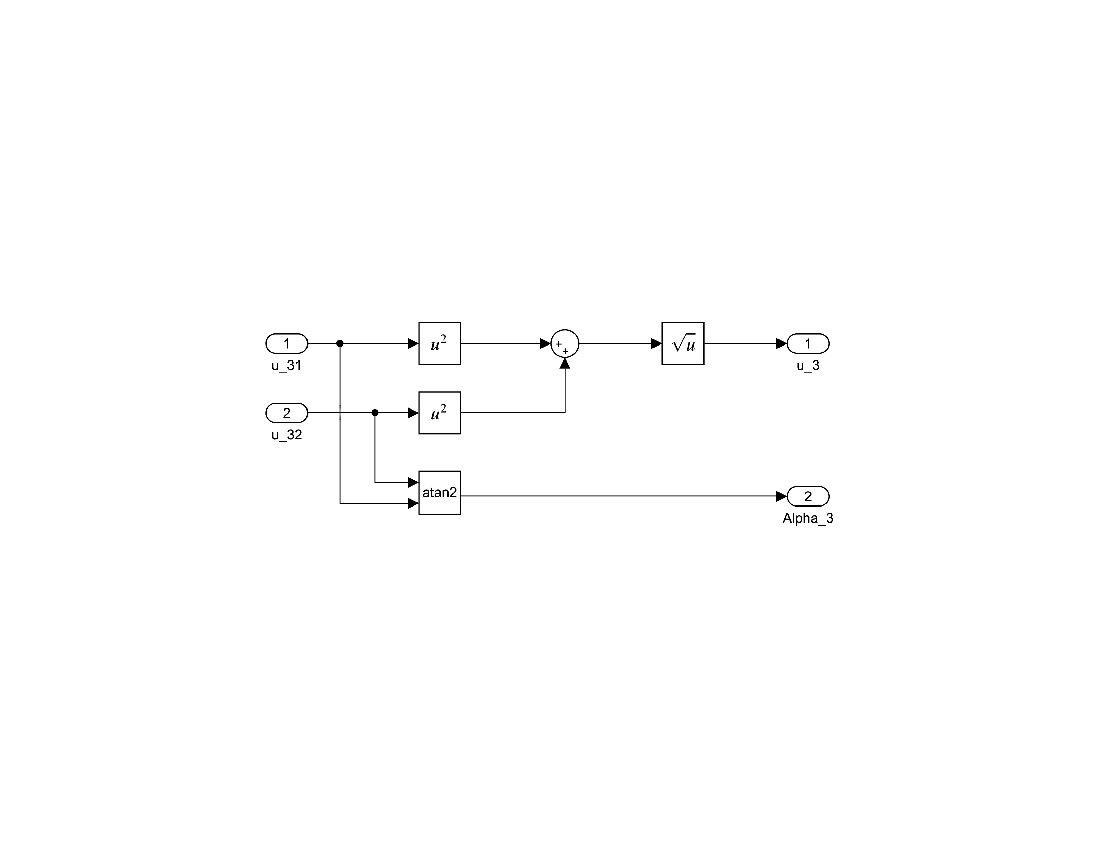
Part 2---Thrust Allocation
thruster number 3

Slide 17
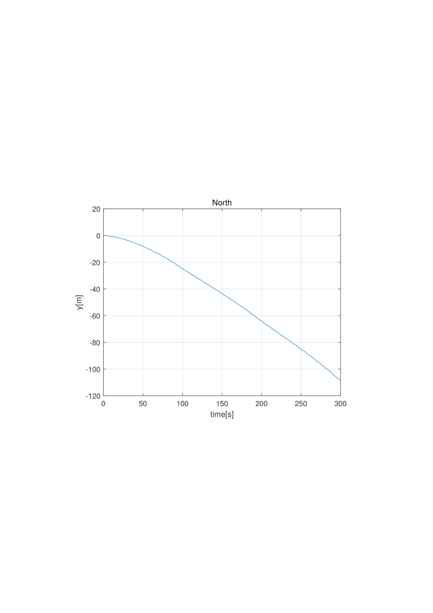
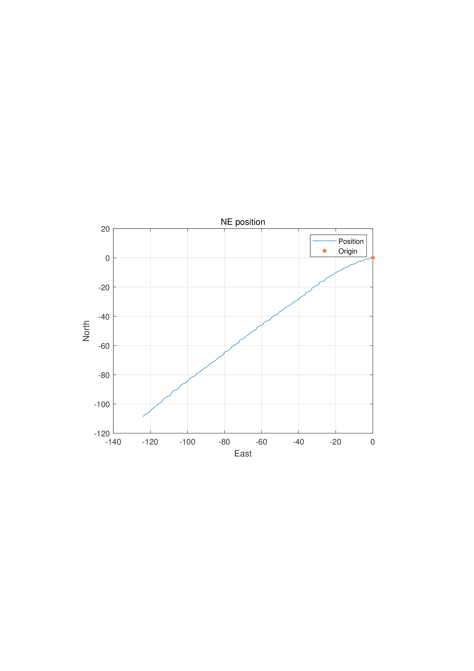
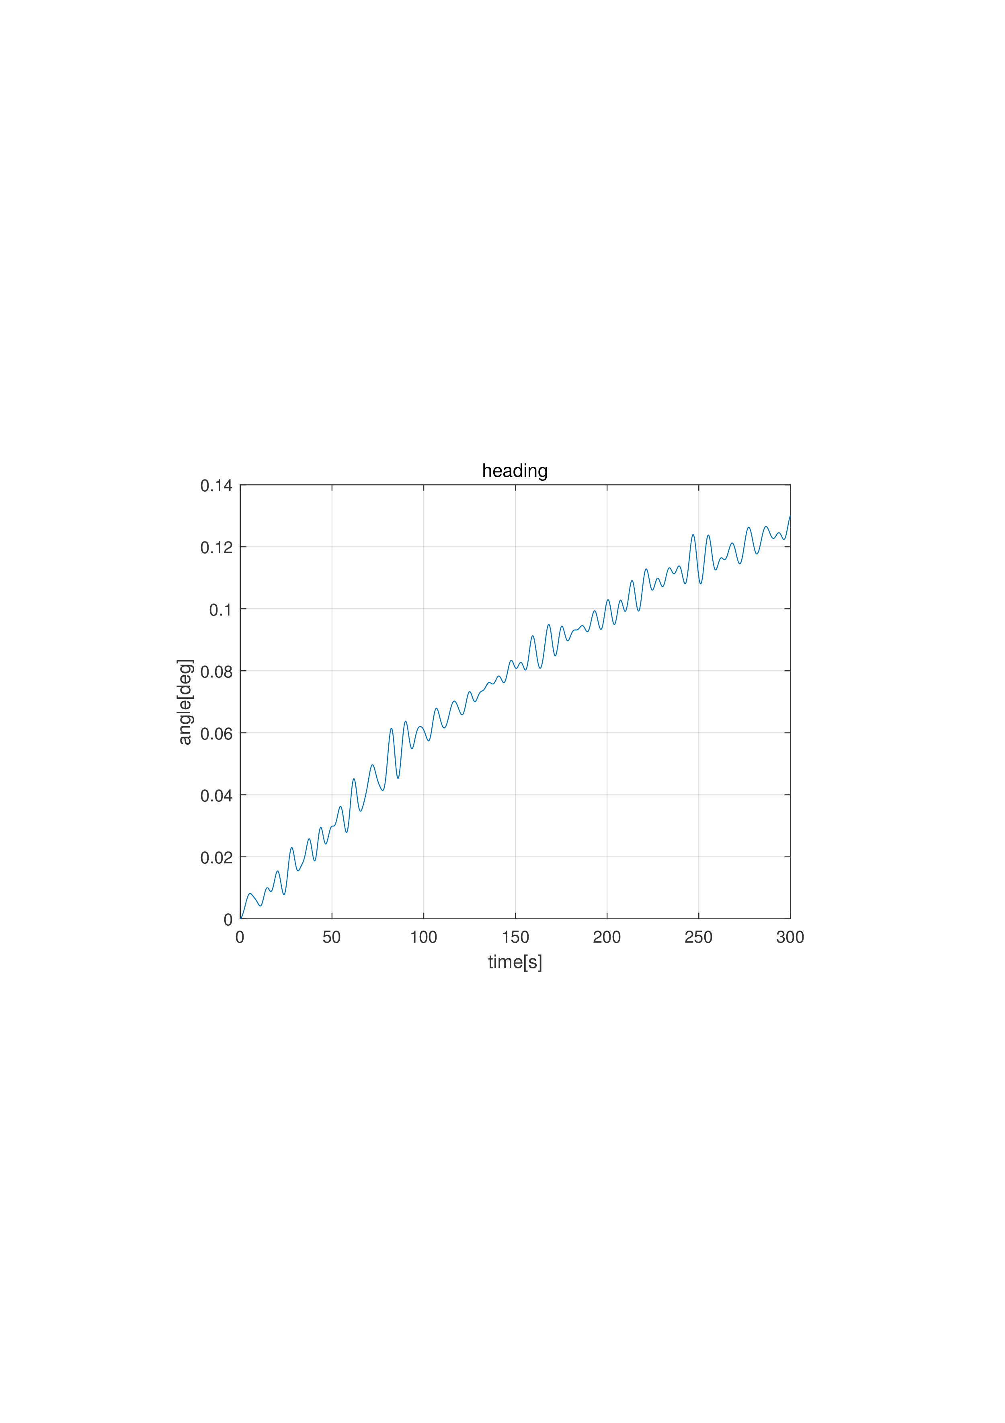
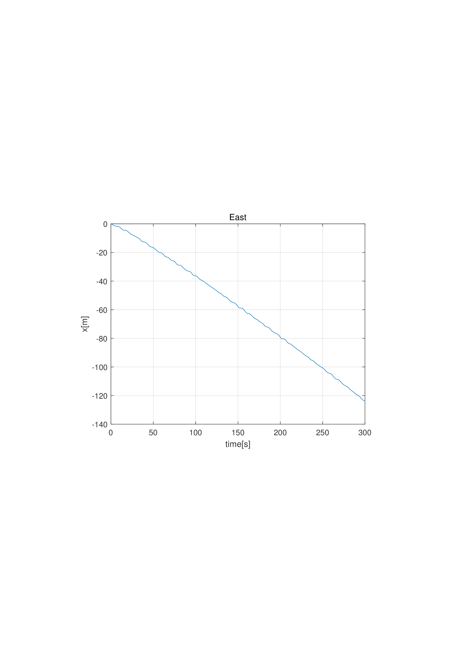
Part 2---Simulation and Discussion
Simulation 1 - Environmental Loads

Slide 18
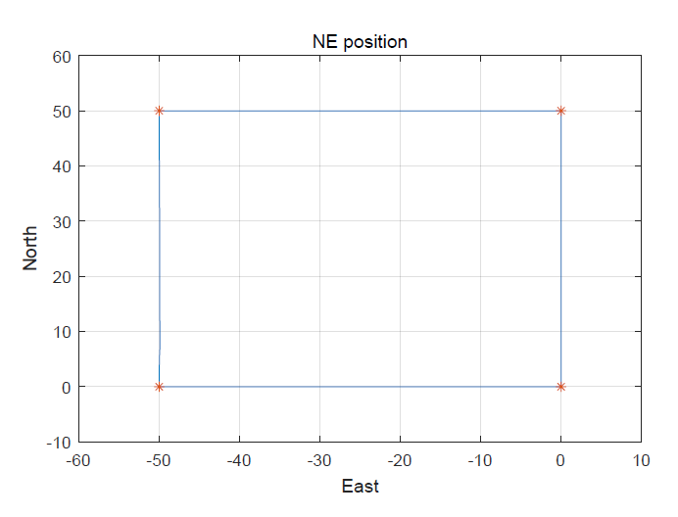
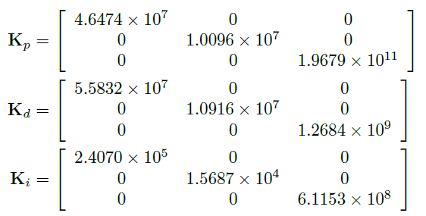
Part 2---Simulation and Discussion
Simulation 2 - DP and Thrust Allocation

Slide 19
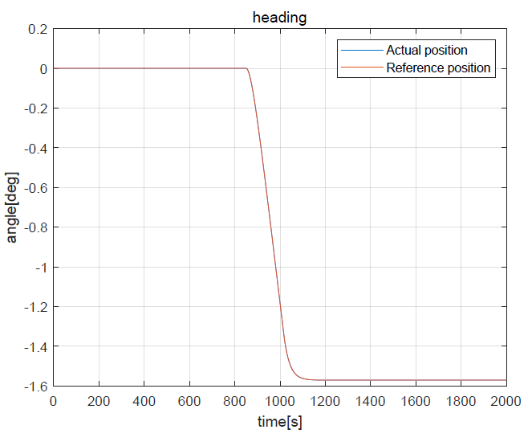
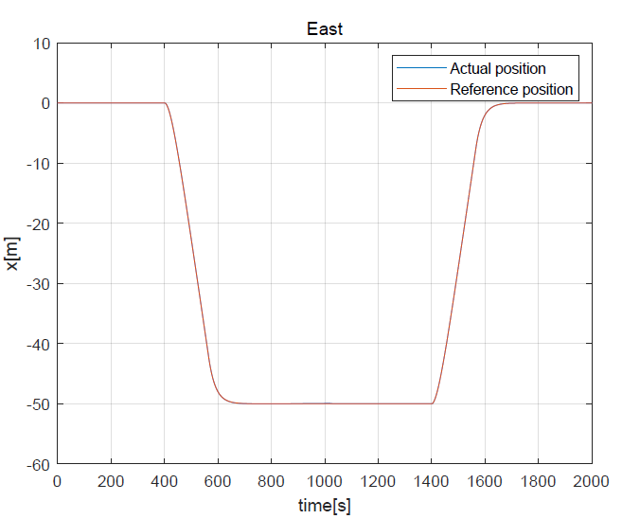
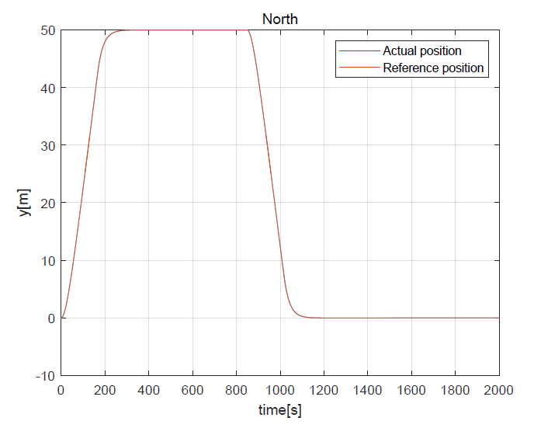
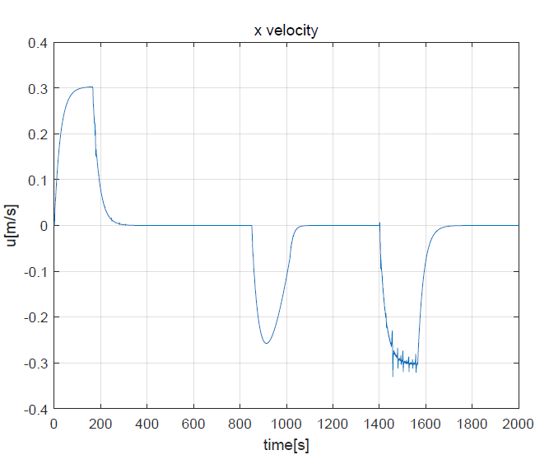
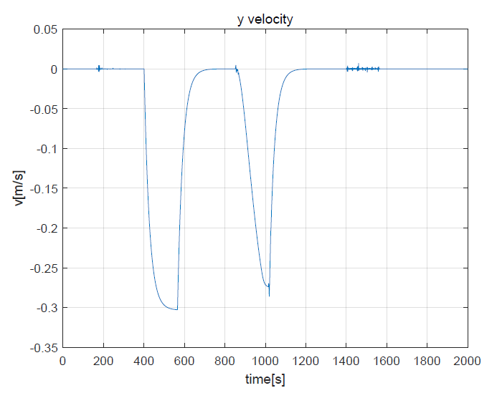
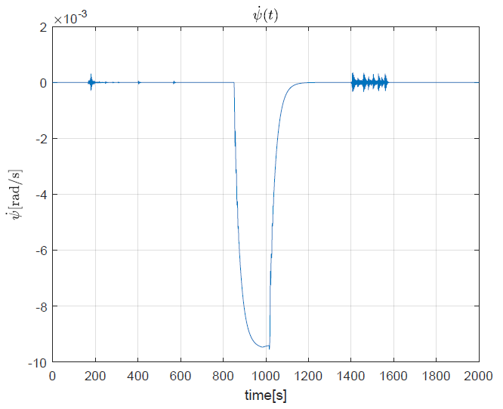
Part 2---Simulation and Discussion
Simulation 2 - DP and Thrust Allocation

Slide 20
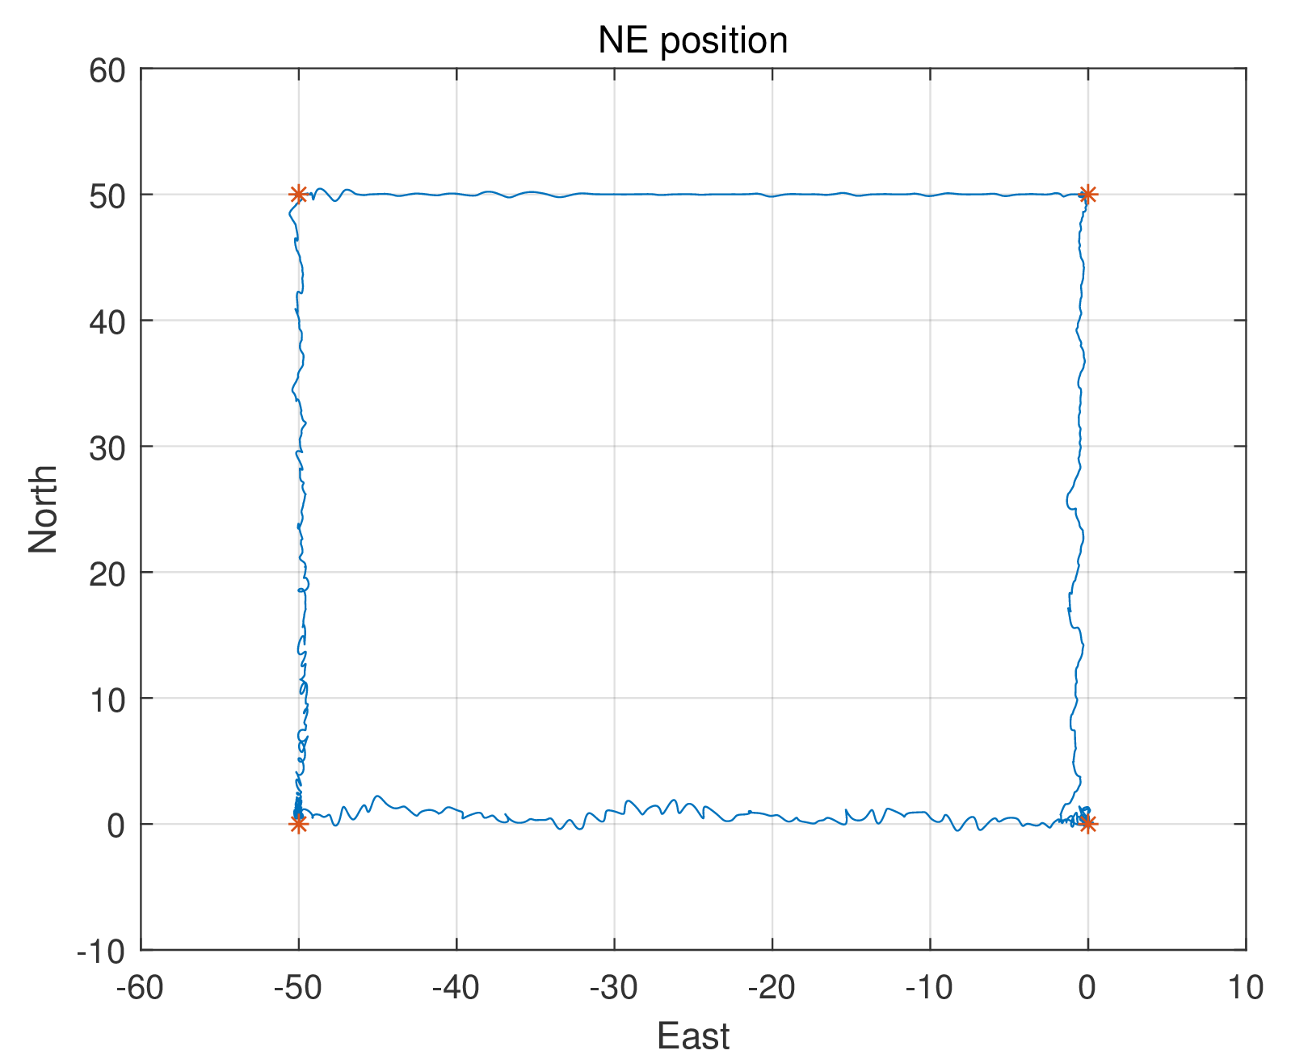
Part 2---Simulation and Discussion
Simulation 3 - DP and Environmental Forces

Slide 21
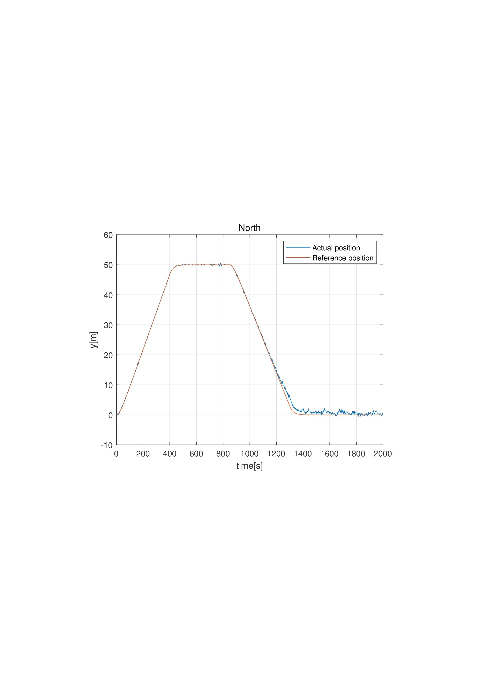
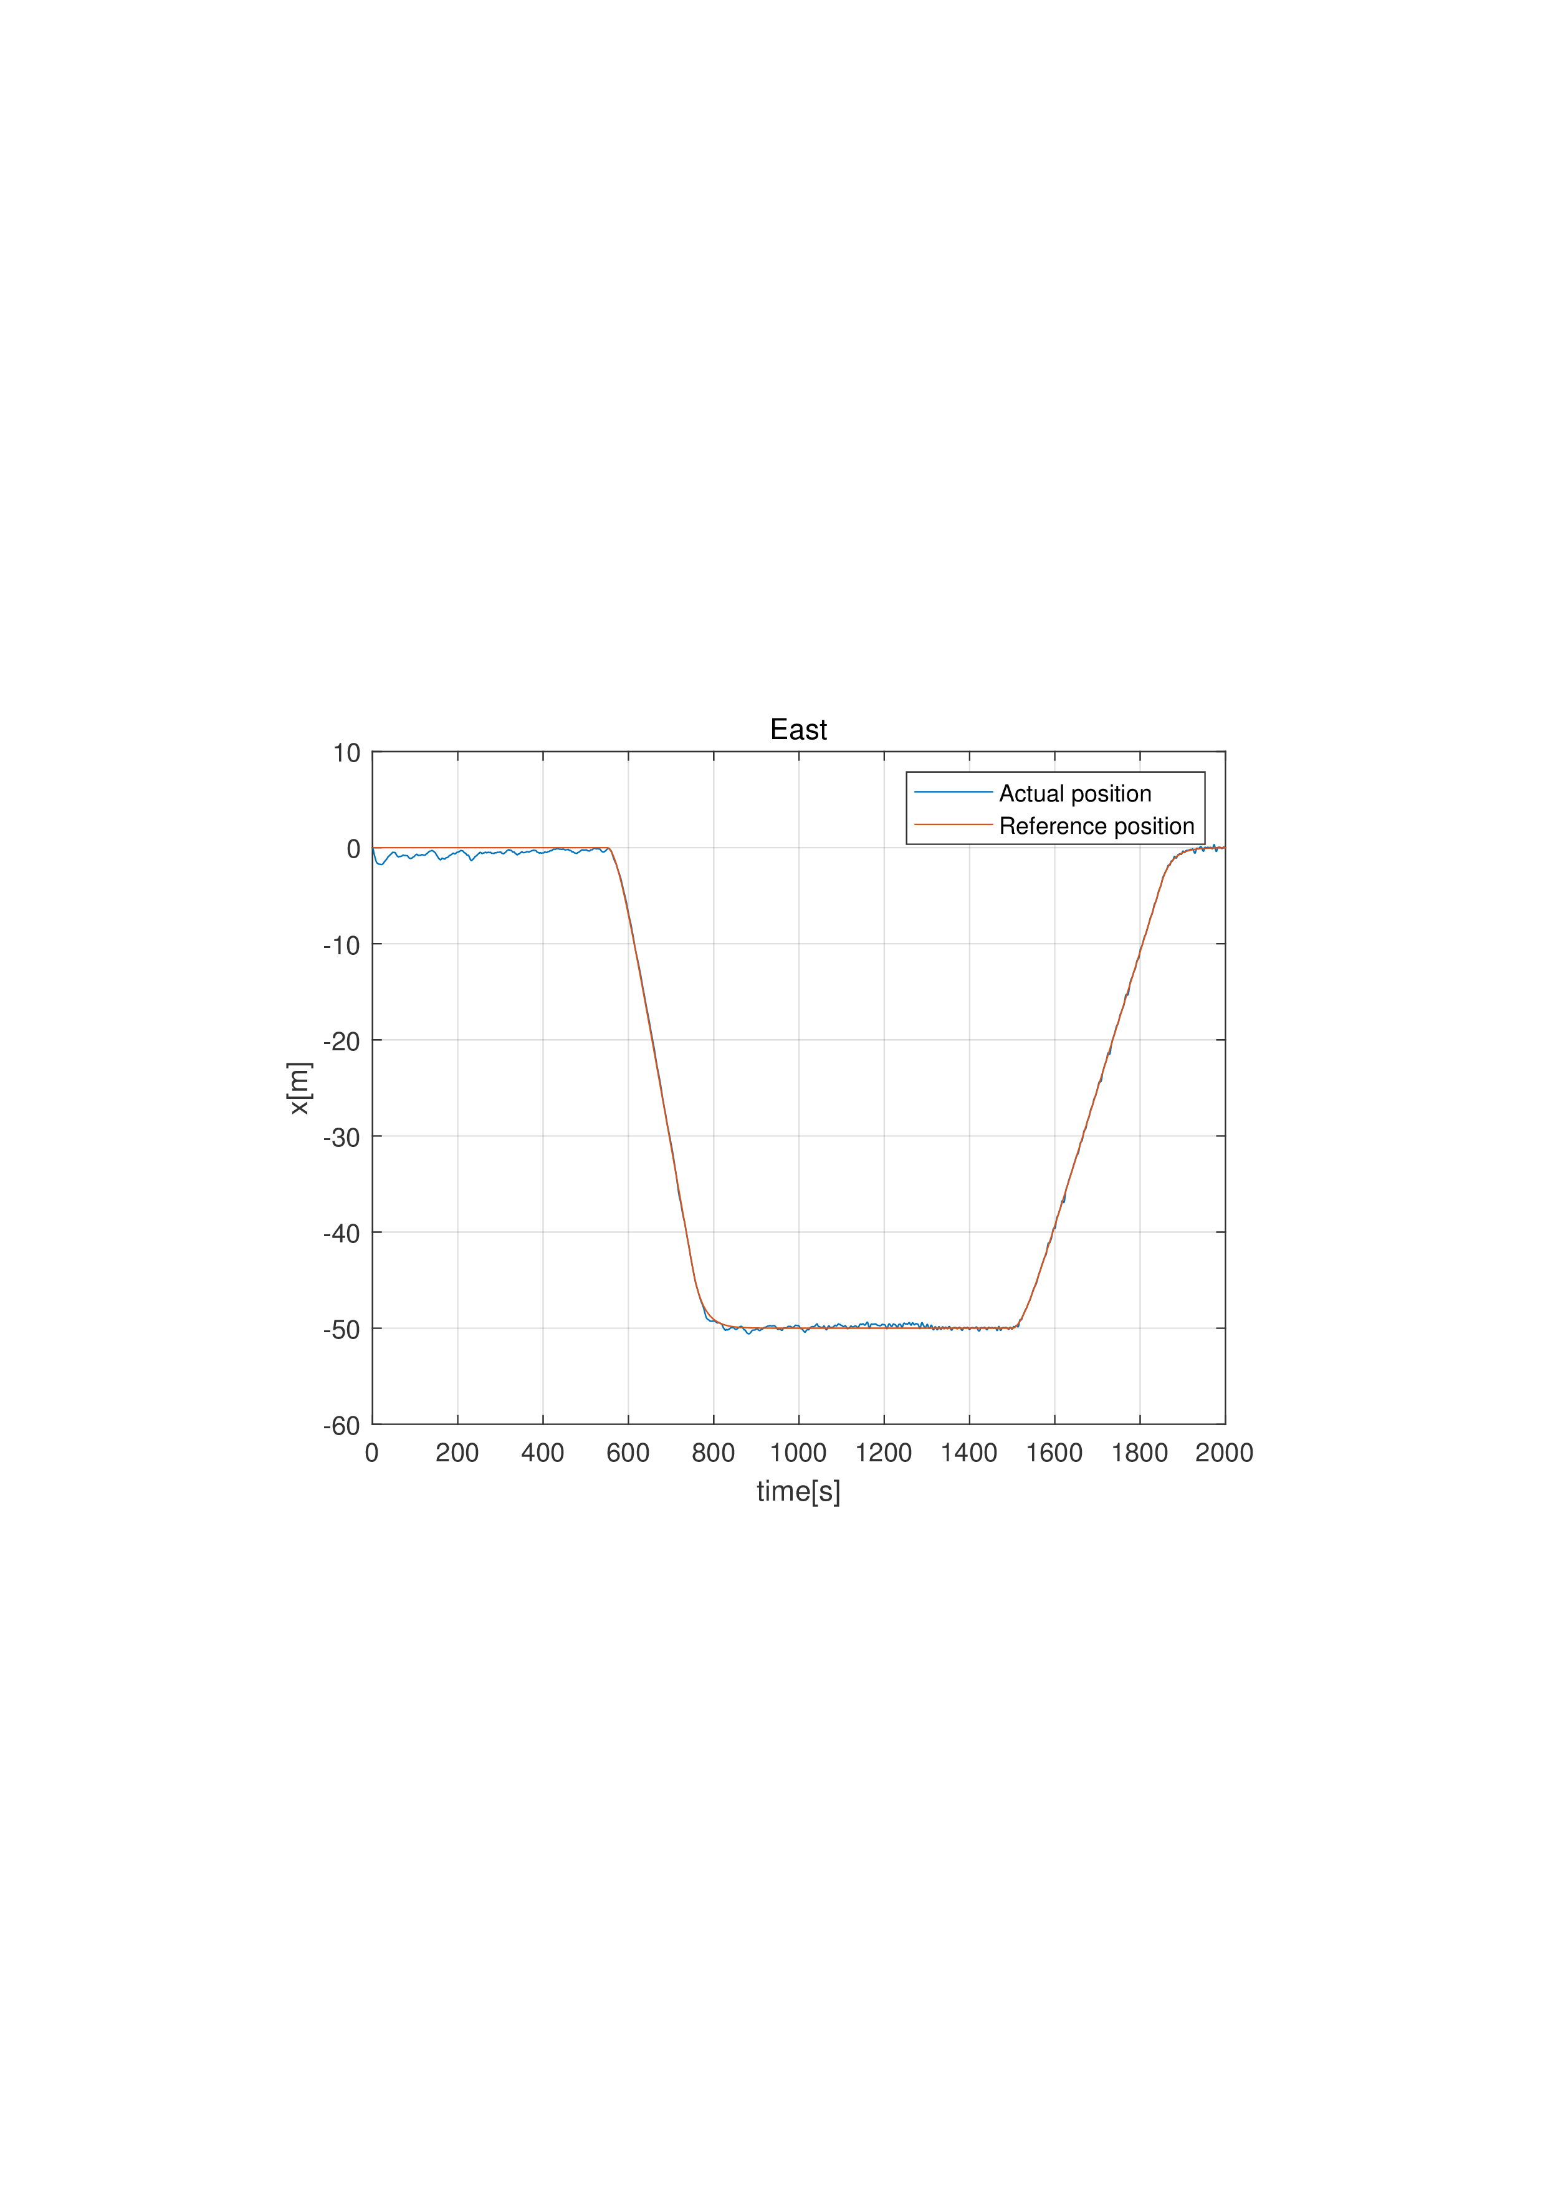
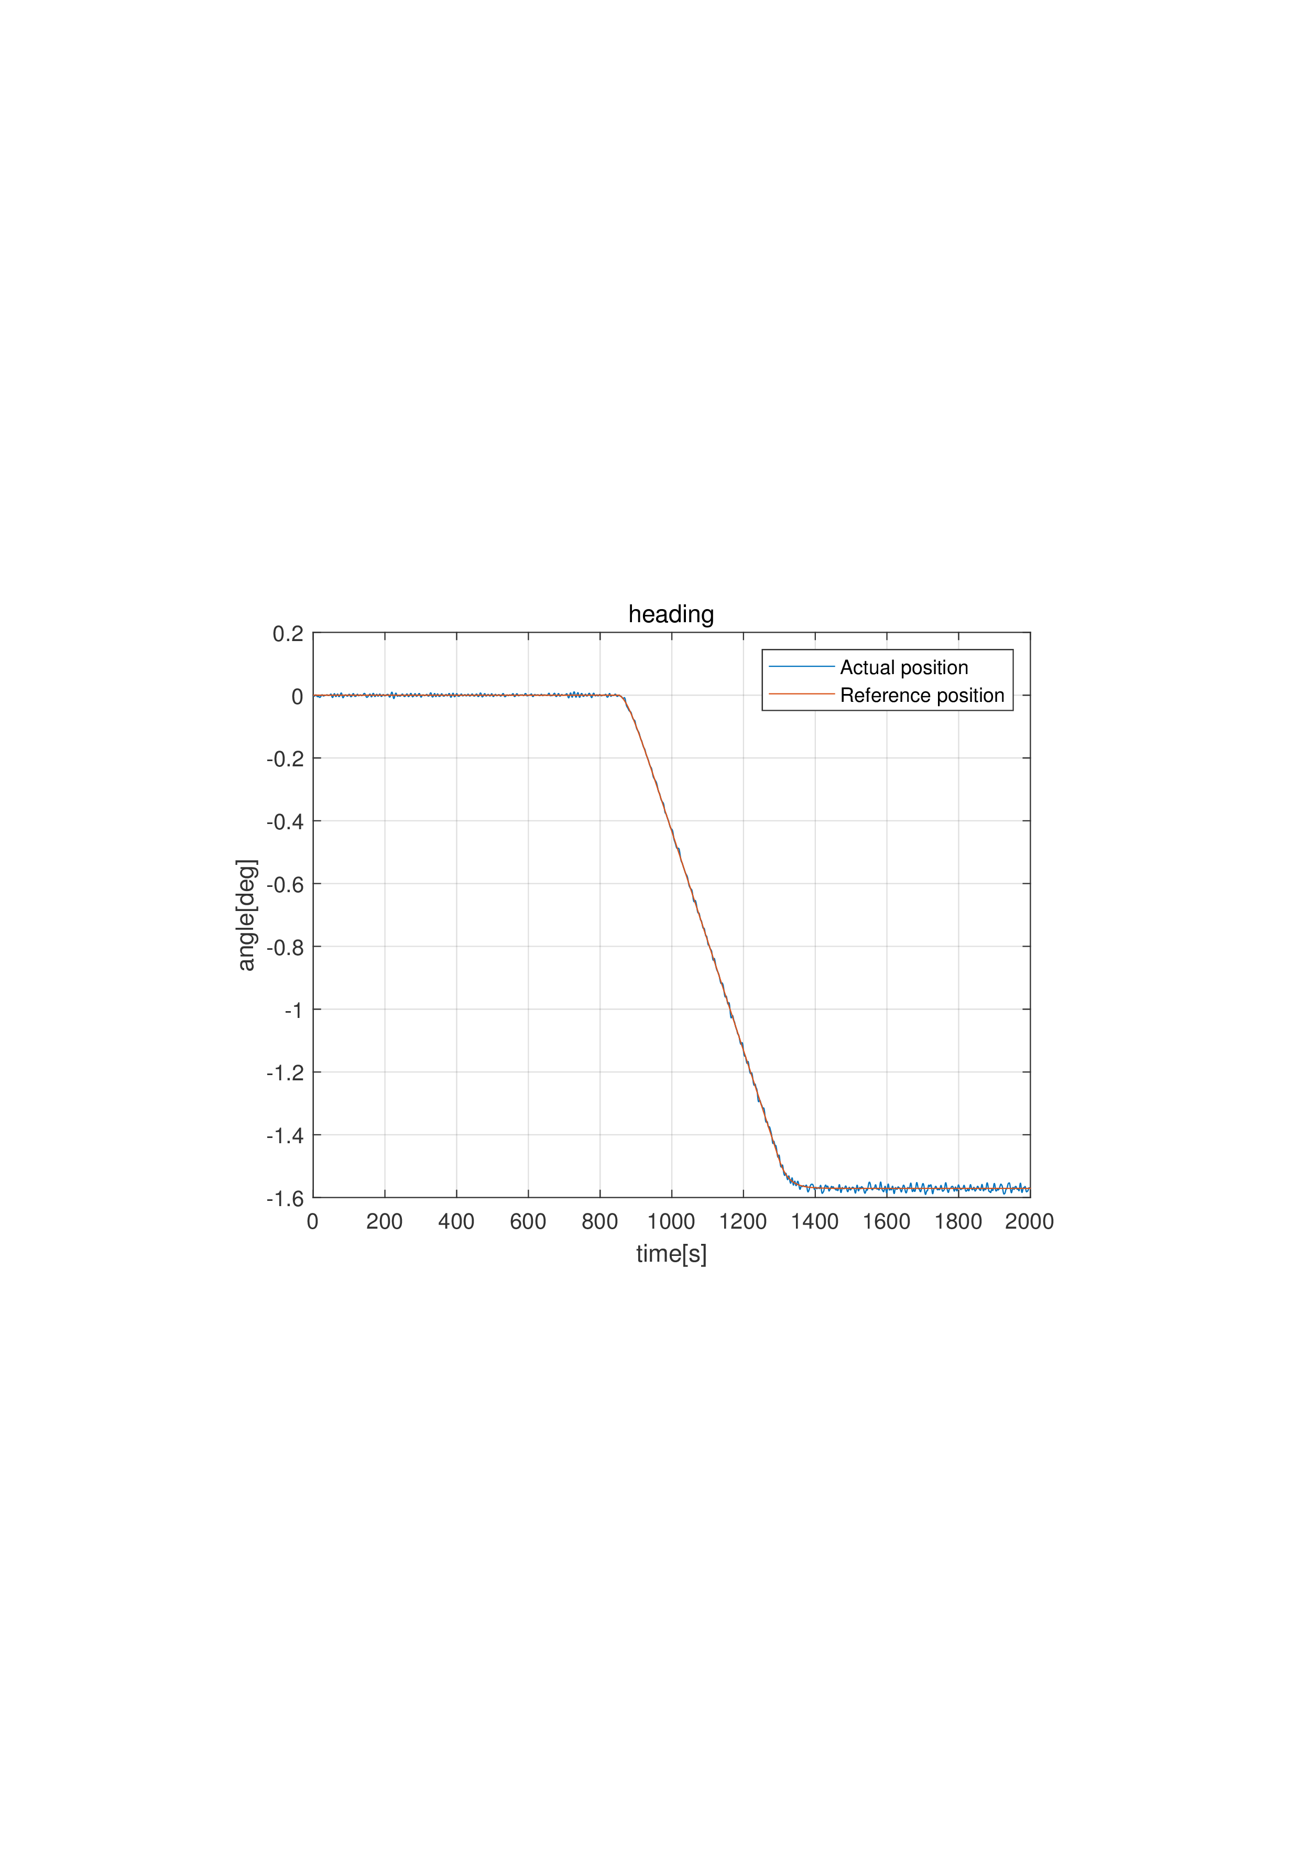



Part 2---Simulation and Discussion
Simulation 3 - DP and Environmental Forces

Slide 22



Part 2---Simulation and Discussion
Simulation 4---EKF

Slide 23



Part 2---Simulation and Discussion
Simulation 4---Passive Nonlinear Observer

Slide 24



Part 2---Simulation and Discussion
Simulation 5 - Complete Simulation
In the later simulation, passive nonlinear observer is used.

Slide 25






Part 2---Simulation and Discussion
Simulation 5 - Complete Simulation

Slide 26

Part 2---Simulation and Discussion
Simulation 6 - Capability Plot
Head-sea
Beam-sea

Slide 27



Part 2---Simulation and Discussion
Simulation 7 - Observer Robustness Extreme Sea

Slide 28
Conclusion
Parameters tuned for specific environmental condition.
Reference model can be improved
PID controller is useful.
Observer
Failed to tune Extended Kalman Filter as expected.
Passive Nonlinear Observer works well.
Excellent allocation can reduce energy cost.
For head-sea, power needed is minute; Beam-sea otherwise.
In extreme sea, vessel lacks power for dynamic position.

Slide 29
THANK YOU

